Slide 1
Nhi Hin (twitter: @nhihin)
Morgan Newman
Stephen Pederson
Michael Lardelli
Alzheimer’s Disease Genetics Laboratory, The University of Adelaide
facebook.com/forgetfulfish
Bioinformatics Hub, The University of Adelaide
Notes:
Hi everyone. I’m Nhi, a PhD student from the Lardelli lab using zebrafish to investigate familial Alzheimer’s disease using a bioinformatics approach.

Slide 2
Summary
Evidence in a mutation model of familial Alzheimer’s disease to support iron deficiency as an early step in disease progression.
Our approach is an extension to standard RNA-seq analysis that assesses iron homeostasis and its disruption in different conditions (e.g. aging, hypoxia).
Nhi Hin^{1,2}, Morgan Newman², Stephen Pederson¹, Michael Lardelli²
1. Bioinformatics Hub, School of Biological Sciences, The University of Adelaide
2. Alzheimer’s Disease Genetics Laboratory, School of Biological Sciences, The University of Adelaide
@nhihin | facebook.com/forgetfulfish
Notes:
Id like to start with the key takeaway messages on some research I’ve been working on this year. (Read out)
First, we’ve found some early evidence in …
Second, we’d also really like to highlight the fact that our approach is an extension to standard RNA-seq analysis that has the potential to assess iron homeostasis and its disruption in different conditions (e.g. aging, hypoxia).

Slide 3
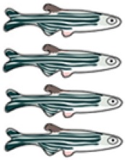
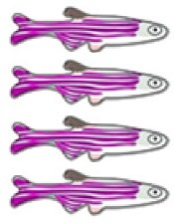
RNA-seq
Samples & Study Design
Hypoxia
Hypoxia
24 months
Aging
Normoxia
6 months
Mutation
+/+
psen1 ^{Q96K97/+}
Notes:
Our study design was designed to be able to compare gene expression in the brain between heterozygous mutants and their wild-type siblings, at a young adult age, and also at an older age when the zebrafish were infertile. Because aging and hypoxia, or (low brain oxygen) are important risk factors for sporadic AD, we also included these conditions. As you can see here, we have 8 conditions and each condition has four biological replicates.

Slide 4
Age
RNA-seq + data processing
quality trimming
aligning to reference zebrafish genome
quantifying gene expression
Library prep
cDNA from whole brains extracted and prepared for RNA-seq by Morgan
Similarity of samples based on overall expression of ~18,000 quantified genes
Notes:
We extracted whole brains from the zebrafish and used these to perform RNA-sequencing.
With RNA-sequencing, we were able to quantify approximately 18,000 genes reliably across all samples. We can use Principal Component Analysis to visualise the overall similarity of samples based on expression of all these genes, and at first glance, we do see that age is the main source of variation in gene expression in the samples, while it’s harder to separate out the changes due to the heterozygous mutation, or hypoxia.

Slide 5
Age
Differentially expressed genes: FDR-adjusted p-value from moderated t-test < 0.05
Notes:
One of the main aims of our research was to investigate changes in gene expression in mutants compared to their wild-type siblings, as these might give us clues as to what was happening in a familial Alzheimer’s disease brain at a younger age before the disease had developed. To explore these changes between mutants and wild-types in more detail, which might be more subtle, we used a method called gene set enrichment analysis.

Slide 6
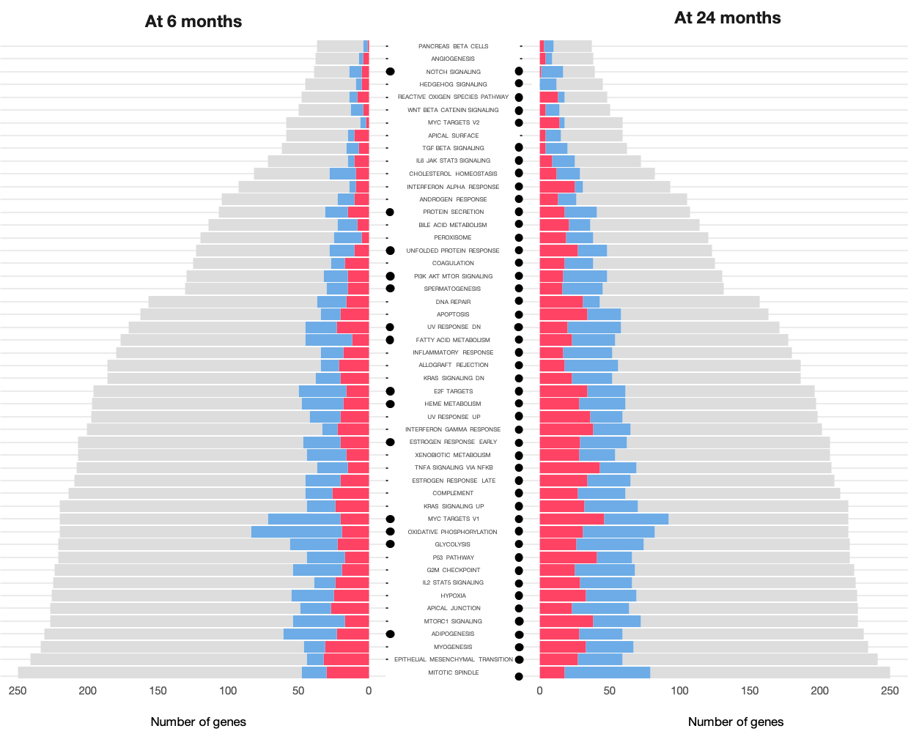
Down
Up
FDR-adjusted p-value from Gene Set Enrichment Analysis with fry, camera, and fgsea < 0.05
Notes:
So a gene set can basically be thought of as a list of genes involved in the same biological pathway. Each row of this plot here is a different gene set from the Molecular Signatures Database, which includes a diverse range genesets covering all the main biological activities and responses like for example oxidative phosphorylation and inflammatory response.
The dots indicate gene sets which were significantly enriched in the comparison between mutants and wild-types at 6 months (left), and at 24 months (right). Within the gene set, we can also see the proportion of genes which were significantly downregulated or upregulated by these colours here.
As you can see, at an old age, almost every biological pathways shows some alteration, which is supportive of the pathological state in aged familial Alzheimer’s disease brains. However, at a younger age as you can see on the left here, fewer pathways are altered, and these are important as they could give us clues as to biological processes which are altered earlier on.

Slide 7
Notes:
I’d like to highlight heme metabolism, as well as ox phos and glycolysis here as pathways which were significantly altered in the young mutant brains relative to wild-type siblings. We can see that early on, there is quite a bit of downregulation with the genes that are part of oxidative phosphorylation, and there is some alteration with glycolysis as well, suggesting some problems with energy metabolism.
(show p-values)

Slide 8
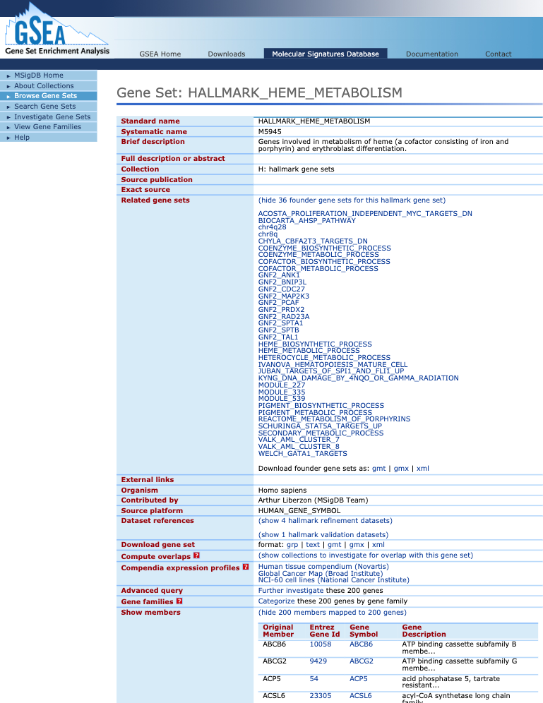
How do we define a more comprehensive and sensitive set of genes that we can use to assess iron homeostasis responses and how they differ between conditions?
Hallmark Heme Metabolism
Set of ~200 genes involved in metabolism of heme, based on 36 independently curated gene sets
Iron Responsive Elements (IREs)
Notes:
The Heme Metabolism gene set from the Molecular Signatures DB is a set of ~200 genes involved in metabolism of heme.

Slide 9
Iron Responsive Elements (IREs)
Hallmark Heme Metabolism
Under iron deficient conditions:
Set of 200 genes involved in metabolism of heme, based on 36 independently curated gene sets

Slide 10
393 genes with 5’ IREs
Other gene sets from MSigDB showing overlap with IRE gene sets (enrichment FDR p-value < 0.05)
1,207 genes with 3’ IREs
Hallmark Heme Metabolism
Genes with IREs were identified by searching all reference zebrafish transcripts for IRE stem-loop motifs with SIREs.

Slide 11
Age

Slide 12
Age
5’IRE
5’IRE
3’IRE
3’IRE
5’IRE
5’IRE
3’IRE
3’IRE
5’IRE
3’IRE
enrichment
p <
-1
-2
-3
10
10
10

Slide 13
Age
5’IRE
3’IRE
5’IRE
3’IRE
enrichment
p <
-1
-2
-3
10
10
10

Slide 14
Increased expression in young mutants
Young Q96K97/+ vs. wild type
Aged Q96K97/+ vs. wild type
Aged wild type vs. young wild type
Young hypoxia vs. normoxia
sox2
alk
ajap1
sf1
dido1
cby1
sik2b
cse1l
relt
fbxo8
prdx2
ggps1
lclat1
siva1
ap1ar
jak1
qdpra
sall4
nelfa
fbxo5
pag1
sncga
thap7
areg
c1d
ntrk3a
sgip1a
agpat2
ndrg3a
ndrg3b
ctps1a
cyth1b
p2ry13
arl13b
cplx4c
ube2r2
ubap2b
sh3gl2b
adnp2a
slc29a4
ccdc62
smurf2
kdm3b
tmcc1b
zfyve9a
ube2q1
sec22a
st3gal3a
sh3bgrl
olfm2a
bloc1s3
rnf220a
ggt1l2.1
hoxc3a
lrrfip1b
or101-1
slc12a7a
ankrd13c
ralgapa2
ehbp1l1b
ccdc85b
sh3bp5a
sh3pxd2aa
tmem259
RUNDC1
ARHGEF17
selenot1a
zgc:110158
si:dkey-280e21.3
si:dkey-16j16.4
si:dkey-239i20.2
si:zfos-128g4.2
si:dkey-174i8.1
si:ch211-227m13.1
si:ch211-212d10.1
115 3’ IRE-containing genes with t-statistic > 2 in the young Q96K97/+ vs. wild type comparison
Notes:
Group 1
May represent the “early response” in the mutants.
These genes are up only in young mutants, but do not go up with normal aging or hypoxia, indicating that they are specific to the mutation.
Group 2
These are genes that show decreased expression in aging, hypoxic response, and also in the mutants as well (relative to age matched siblings).
Group 3
These genes tend to show increased expression in aging, hypoxic response, and also in mutants. May be slightly weaker in the 24 month old mutants but overall quite similar between the comparisons shown.
Group 4
This small group of genes shows consistent decreased expression in mutants but mixed patterns during aging or hypoxia.
May represent mutant-specific genes.
Group 5
Increased expression in young mutants. Some are also increased under aging, hypoxic response, or in the aged mutants, to differing extents.

Slide 15
Decreased with aging, hypoxia, and mutation
Young Q96K97/+ vs. wild type
Aged Q96K97/+ vs. wild type
Aged wild type vs. young wild type
Young hypoxia vs. normoxia
sox2
alk
ajap1
sf1
dido1
cby1
sik2b
cse1l
relt
fbxo8
prdx2
ggps1
lclat1
siva1
ap1ar
jak1
qdpra
sall4
nelfa
fbxo5
pag1
sncga
thap7
areg
c1d
ntrk3a
sgip1a
agpat2
ndrg3a
ndrg3b
ctps1a
cyth1b
p2ry13
arl13b
cplx4c
ube2r2
ubap2b
sh3gl2b
adnp2a
slc29a4
ccdc62
smurf2
kdm3b
tmcc1b
zfyve9a
ube2q1
sec22a
st3gal3a
sh3bgrl
olfm2a
bloc1s3
rnf220a
ggt1l2.1
hoxc3a
lrrfip1b
or101-1
slc12a7a
ankrd13c
ralgapa2
ehbp1l1b
ccdc85b
sh3bp5a
sh3pxd2aa
tmem259
RUNDC1
ARHGEF17
selenot1a
zgc:110158
si:dkey-280e21.3
si:dkey-16j16.4
si:dkey-239i20.2
si:zfos-128g4.2
si:dkey-174i8.1
si:ch211-227m13.1
si:ch211-212d10.1
115 3’ IRE-containing genes with t-statistic > 2 in the young Q96K97/+ vs. wild type comparison
Notes:
Group 1
May represent the “early response” in the mutants.
These genes are up only in young mutants, but do not go up with normal aging or hypoxia, indicating that they are specific to the mutation.
Group 2
These are genes that show decreased expression in aging, hypoxic response, and also in the mutants as well (relative to age matched siblings).
Group 3
These genes tend to show increased expression in aging, hypoxic response, and also in mutants. May be slightly weaker in the 24 month old mutants but overall quite similar between the comparisons shown.
Group 4
This small group of genes shows consistent decreased expression in mutants but mixed patterns during aging or hypoxia.
May represent mutant-specific genes.
Group 5
Increased expression in young mutants. Some are also increased under aging, hypoxic response, or in the aged mutants, to differing extents.

Slide 16
Increased with aging, hypoxia, and mutation
Young Q96K97/+ vs. wild type
Aged Q96K97/+ vs. wild type
Aged wild type vs. young wild type
Young hypoxia vs. normoxia
sox2
alk
ajap1
sf1
dido1
cby1
sik2b
cse1l
relt
fbxo8
prdx2
ggps1
lclat1
siva1
ap1ar
jak1
qdpra
sall4
nelfa
fbxo5
pag1
sncga
thap7
areg
c1d
ntrk3a
sgip1a
agpat2
ndrg3a
ndrg3b
ctps1a
cyth1b
p2ry13
arl13b
cplx4c
ube2r2
ubap2b
sh3gl2b
adnp2a
slc29a4
ccdc62
smurf2
kdm3b
tmcc1b
zfyve9a
ube2q1
sec22a
st3gal3a
sh3bgrl
olfm2a
bloc1s3
rnf220a
ggt1l2.1
hoxc3a
lrrfip1b
or101-1
slc12a7a
ankrd13c
ralgapa2
ehbp1l1b
ccdc85b
sh3bp5a
sh3pxd2aa
tmem259
RUNDC1
ARHGEF17
selenot1a
zgc:110158
si:dkey-280e21.3
si:dkey-16j16.4
si:dkey-239i20.2
si:zfos-128g4.2
si:dkey-174i8.1
si:ch211-227m13.1
si:ch211-212d10.1
115 3’ IRE-containing genes with t-statistic > 2 in the young Q96K97/+ vs. wild type comparison
Notes:
Group 1
May represent the “early response” in the mutants.
These genes are up only in young mutants, but do not go up with normal aging or hypoxia, indicating that they are specific to the mutation.
Group 2
These are genes that show decreased expression in aging, hypoxic response, and also in the mutants as well (relative to age matched siblings).
Group 3
These genes tend to show increased expression in aging, hypoxic response, and also in mutants. May be slightly weaker in the 24 month old mutants but overall quite similar between the comparisons shown.
Group 4
This small group of genes shows consistent decreased expression in mutants but mixed patterns during aging or hypoxia.
May represent mutant-specific genes.
Group 5
Increased expression in young mutants. Some are also increased under aging, hypoxic response, or in the aged mutants, to differing extents.

Slide 17
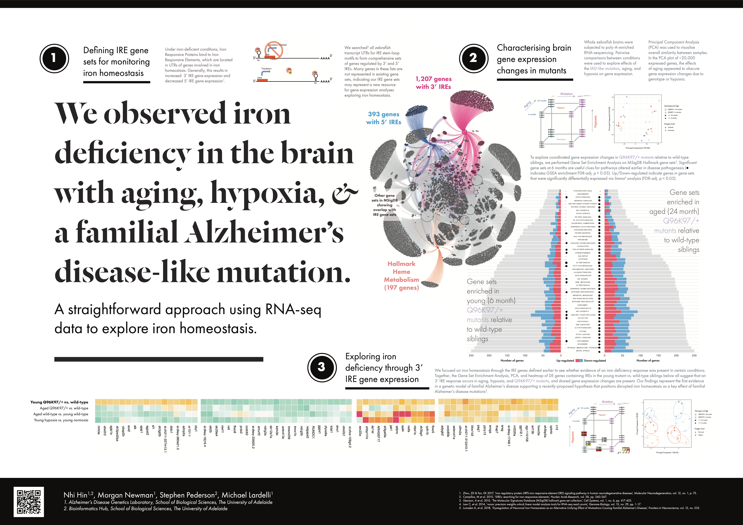
sox2
alk
ajap1
sf1
dido1
cby1
sik2b
cse1l
relt
fbxo8
prdx2
ggps1
lclat1
siva1
ap1ar
jak1
qdpra
sall4
nelfa
fbxo5
pag1
sncga
thap7
areg
c1d
ntrk3a
sgip1a
agpat2
ndrg3a
ndrg3b
ctps1a
cyth1b
p2ry13
arl13b
cplx4c
ube2r2
ubap2b
sh3gl2b
adnp2a
slc29a4
ccdc62
smurf2
kdm3b
tmcc1b
zfyve9a
ube2q1
sec22a
st3gal3a
sh3bgrl
olfm2a
bloc1s3
rnf220a
ggt1l2.1
hoxc3a
lrrfip1b
or101-1
slc12a7a
ankrd13c
ralgapa2
ehbp1l1b
ccdc85b
sh3bp5a
sh3pxd2aa
tmem259
RUNDC1
ARHGEF17
selenot1a
zgc:110158
si:dkey-280e21.3
si:dkey-16j16.4
si:dkey-239i20.2
si:zfos-128g4.2
si:dkey-174i8.1
si:ch211-227m13.1
si:ch211-212d10.1
Notes:
Group 1
May represent the “early response” in the mutants.
These genes are up only in young mutants, but do not go up with normal aging or hypoxia, indicating that they are specific to the mutation.
Group 2
These are genes that show decreased expression in aging, hypoxic response, and also in the mutants as well (relative to age matched siblings).
Group 3
These genes tend to show increased expression in aging, hypoxic response, and also in mutants. May be slightly weaker in the 24 month old mutants but overall quite similar between the comparisons shown.
Group 4
This small group of genes shows consistent decreased expression in mutants but mixed patterns during aging or hypoxia.
May represent mutant-specific genes.
Group 5
Increased expression in young mutants. Some are also increased under aging, hypoxic response, or in the aged mutants, to differing extents.

Slide 18
Acknowledgements
Michael Lardelli Stephen Pederson
Alzheimer’s Disease Genetics Laboratory Bioinformatics Hub
Morgan Newman
Karissa Barthelson
Yang Dong
Lachie

